Slide 1
Graph analytics assignment1
Faramarz Zareian
Iman Emrani

Slide 2
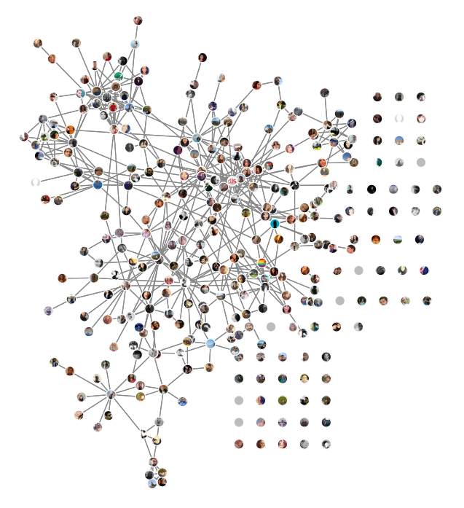
Human resources slide 1
We decided to download a realistic graph , so we downloaded Faramarz Zareian Facebook Friends graph by Lostcircles add-on.
Format of the file is .Gephi So we visualized it with Gephi and all calculations done by Gephi Software.

Slide 3
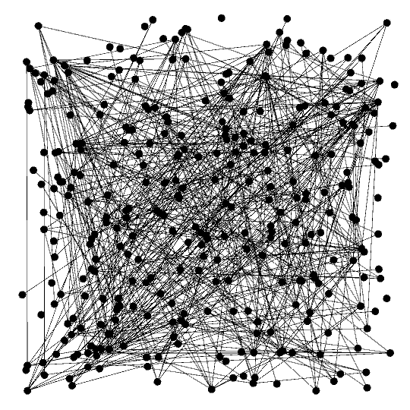
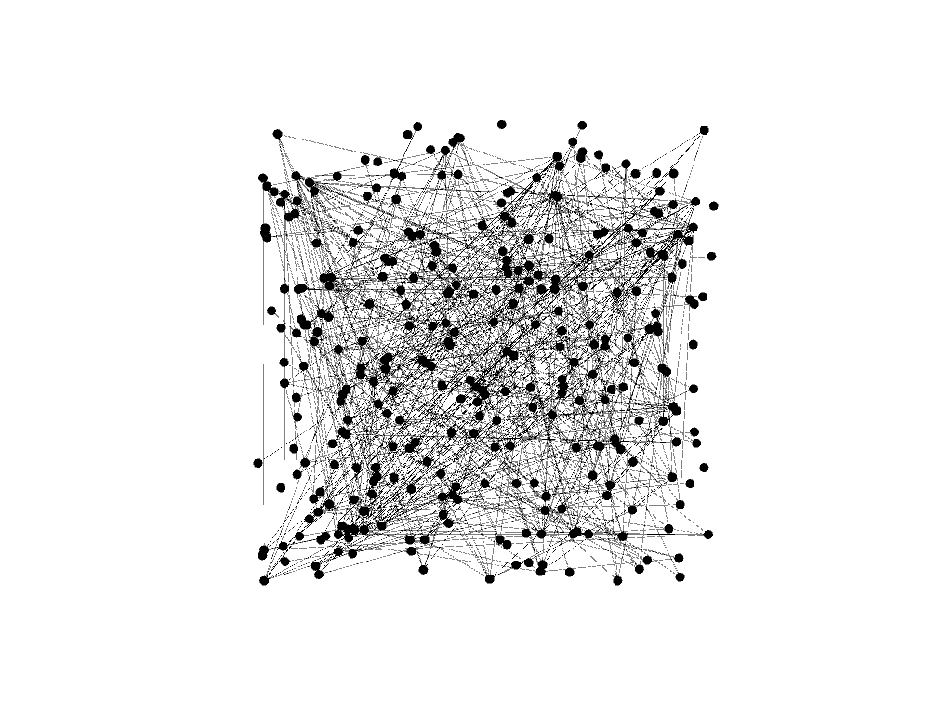
Human resources slide 1
This is the graph of my friends in Facebook which is visualized with Gephi in default model

Slide 4
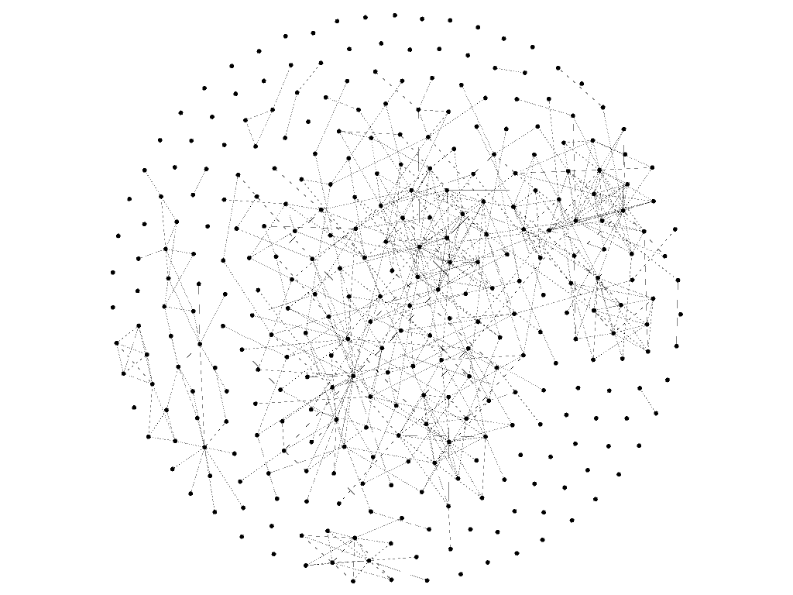
Human resources slide 1
Graph visualized by fruchterman reingold Layout
Nodes : 320
Edges : 1084(un-merged)
542 merged
WE USED A VIZUALIZATION METHOD “FRUCHTERMAN REINGOLD LAYOUT” SO THE GRAPH IS VISUALIZED LIKE A CIRCLE AND THE DENSITY AND CONNECTED NODES ARE MOSTLY IN THE CENTER OF CIRCLE.

Slide 5
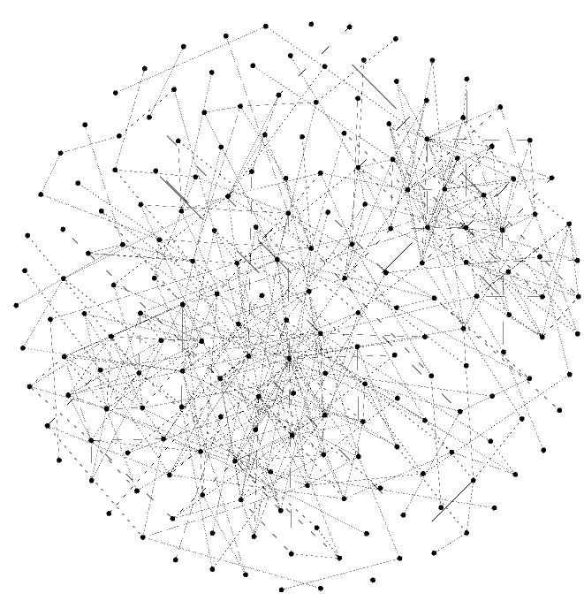
Giant Components
In this Facebook account we have only on Giant Component.

Slide 6
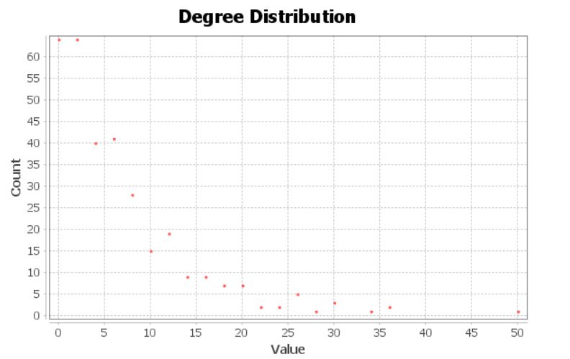
Human resources slide 1
AVERAGE DEGREE : 3.388
There is a few people in Facebook network knows over 60 people , between ( 0 and 5) person and more than that there are people know other people in this network between (0-10) this is the richest part , and at the end Average Degree is ( 3.388).

Slide 7
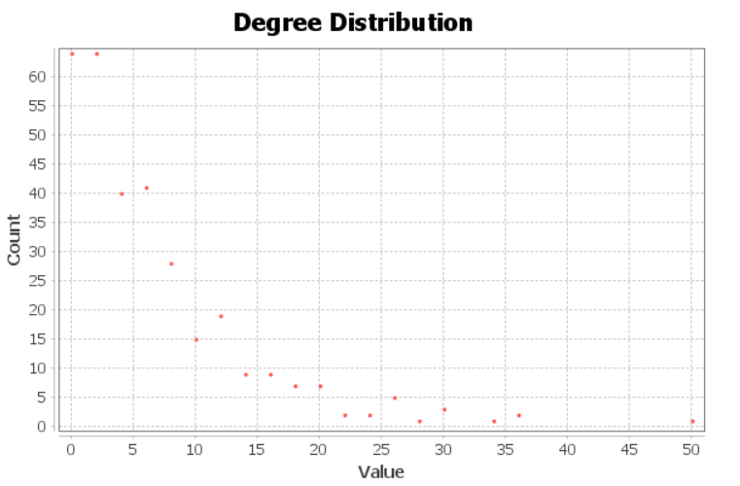
Human resources slide 1
AVERAGE WEIGHTED DEGREE : 6.775
Weight of each degree in this assignment is defined (2) so each node with x degree has a 2x weighted degree and the average weighted degree is 2(average degree= 3.388).

Slide 8
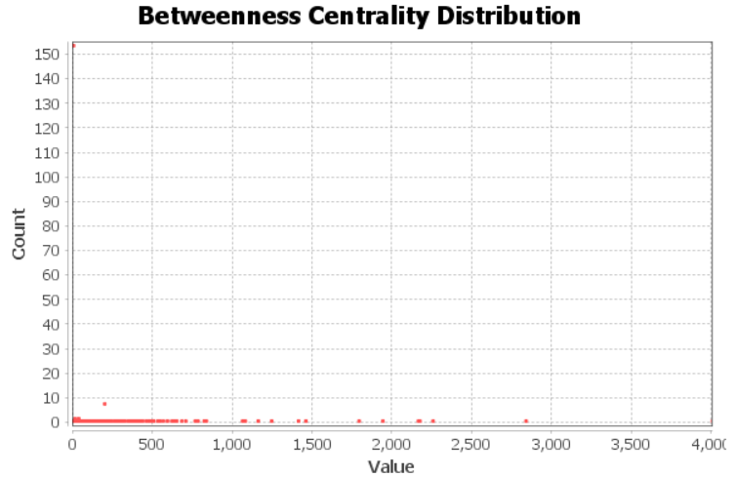
Human resources slide 1
BETWEENNESS CENTRALITY DISTRIBUTION
DIAMETER : 8
RADIUS : 0
AVERAGE PATH LENGTH : 3.960
Diameter in this part means The maximal distance between all pairs of nodes.
As we can see in the picture a path with length of over 150 is there and most of them are between (0-8~9).
And at the end Average of path lengths is 3.96

Slide 9
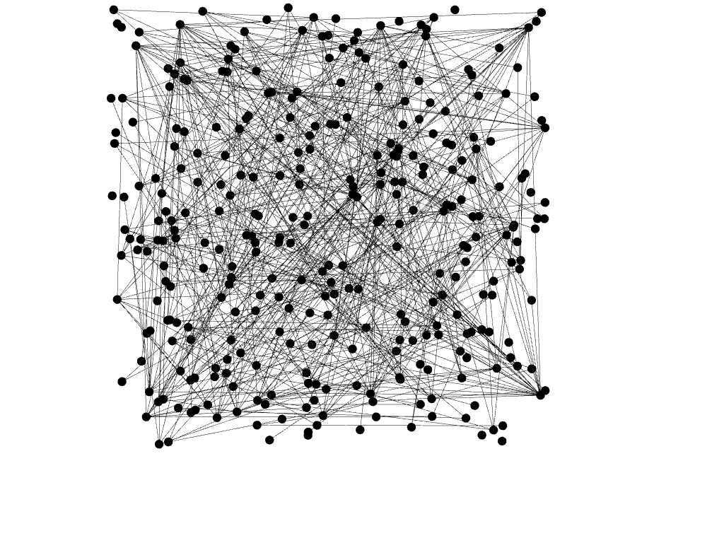
Network density
OUR DENSITY OF THIS NETWORK IS : 0.011
Measures how close the network is to complete. A complete graph has all possible edges and density equal to 1. so we can say this network is absolutely spars.

Slide 10
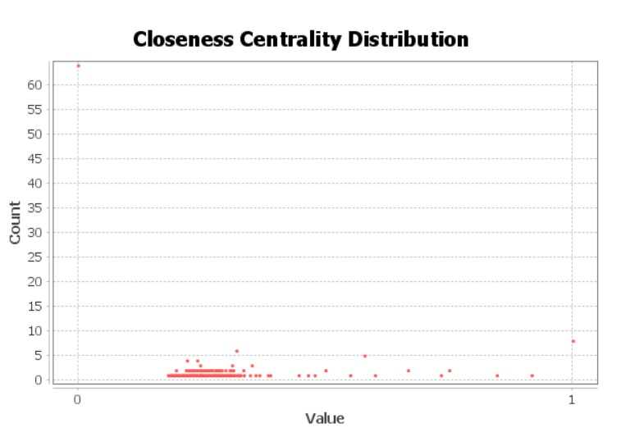
Human resources slide 1
The average distance from a given node to all other nodes in the network.
normalized between (0 -1).

Slide 11
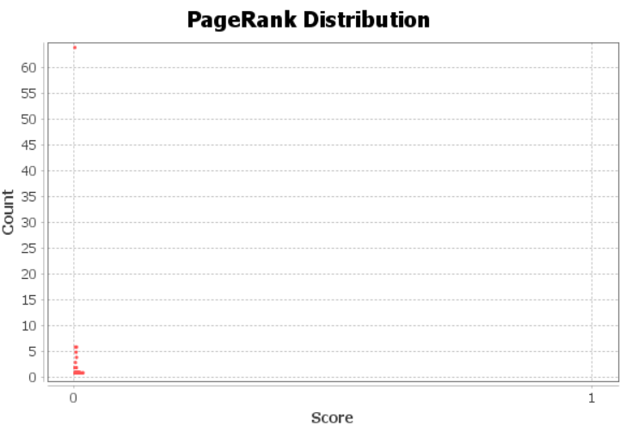
PAGE RANK WITH EPSILON:0.001 , PROBABILITY : 0.85

Slide 12
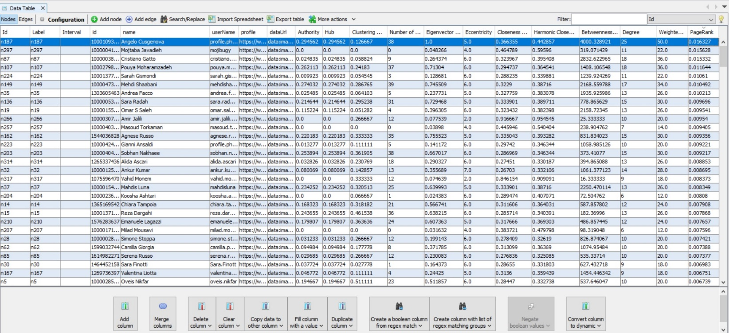
NODE with highest degree and PageRank

Slide 13
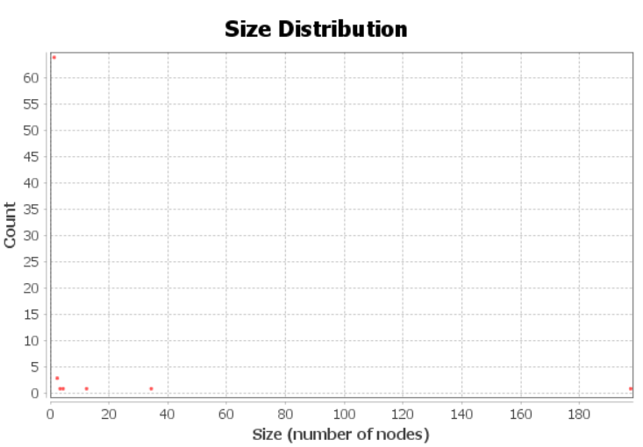
WEAKLY CONNECTED COMPONENTS : 72

